Slide 1
Text Mining III: Information Extraction, Named Entity Recognition and Typing
Jiawei Han
Computer Science
University of Illinois at Urbana-Champaign
May 26, 2025

Slide 2
Outline
Information Extraction: A Brief Introduction
Named Entity Recognition I: Handcrafted Features + Human Annotations
Rule-based and Classical Supervised Approaches
Named Entity Recognition II: Automated Features + Human Annotations
Language Model-Based Supervised Approaches
Named Entity Recognition III: Automated Features + Distant Annotations
Weakly or Distantly Supervised Approaches for Entity Recognition and Typing
Distantly supervised neural network approach: AutoNER
Summary

Slide 3
Information Extraction: Typical Tasks
Information extraction: Discover specific types of useful properties of the tokens in the text and their relationships
The term “information extraction” refers to a family of several closely related tasks
Named entity recognition (NER): The tokens in the text may refer to named entities, such as locations, people, and organizations
Ex. Bill Clinton lives in New York at a location that is a few miles away from an IBM building. He and his wife, Hillary Clinton, relocated to New York after his presidency.
NER: needs to determined which tokens correspond to which type of entity
“New York” is a location, “Bill Clinton” is a person, and “IBM” is an organization, …
Relationship extraction: Follows named entity recognition, find the relationships among different named entities in a sentence
Ex. LocatedIn(Bill Clinton, New York), WifeOf(Bill Clinton, Hillary Clinton)
Co-reference resolution: Different terms may refer to the same entity
Ex. “International Business Machines” and “IBM,” “Bill Clinton” and “He”

Slide 4
Information Extraction: Methodologies & Applications
Three different methodologies
Fully supervised (traditional) method: The types of entities and the relationships among them to be learned are pre-defined, and tagged training data are available
Weakly supervised methods: Either expand a small set of initial relations, or use other knowledge bases from external sources to learn the relations in a corpus
Open information extraction: Unsupervised and has no idea about the types of entities to be mined up front
Information extraction has broad applications
News tracking: track events and interactions/relations between different entities
Counter-terrorism: identify entities, organizations, events, and their relationships
Business and financial intelligence: find e.g., mergers, business agreements, …
Biomedical data: identify genes, proteins, drugs, and diseases & their relationships
Entity-oriented search: Search for persons, locations, and organizations
Question-answering systems: Extract types of entities in Q and their relationships
Scientific libraries: Extract author, title, topic, …
Text segmentation: Many existing NER algorithms can be used for text segmentation

Slide 5
Information Extraction: Historical Evolution & NLP
Early slot-filling: Extract over a pre-defined template table from unstructured text
Highly application dependent, not generalizable across different application settings
Later found: named entity recognition and relationship extraction were often used as subtasks of slot filling, and they are more crisply defined and template independent
Information extraction requires a pipeline of preprocessing tasks related to NLP
Tokenization and preprocessing (e.g., stemming)
Parts-of-speech tagging: Each token is assigned to a part-of-speech tag
Many refined categorization of basic types, (e.g., Brown or Penn Treebank tags)
Ex. NN, NNP, and NNS represent singular, proper, and plural nouns respectively
Ex. VB (base form of a verb), VBD (its past tense)
Ex. DT (determiners, such as “a,” “an,” and “the”)
Ex. “The/DT rabbit/NN ate/VBD the/DT carrot/NN”

Slide 6
Information Extraction: Preprocessing Using NLP
Parser: Extracts a hierarchical structure from each sentence in the form of a parse tree
The lower-level subtrees group the parts of speech into syntactically coherent phrases like noun phrases and verb phrases
Noun phrase is useful for named entity recognition
Verb phrase is useful for relationship extraction
Dependency analyzer: Some words depend on others
Ex. Both “rabbit” and “carrot” depend on “ate”
One can encode these dependencies in the form of a dependency graph: Nodes represent words and directed edges represent dependencies
Useful for relationship extraction
A constituency-based parse tree that includes both the parts-of-speech tags and the phrase tags
There are many off-the-shelf NLP libraries, such as Stanford CoreNLP, NLTK toolkit, and the Apache OpenNLP
Adjectives extracted are useful for opinion mining

Slide 7
Named Entity Recognition (NER)
A named entity typically refers to a sequence of words that correspond to a specific entity in the real world (i.e., an entity with a name) (e.g., “Bill Clinton”)
Most NER methods focus on three types of entities: person, location, and organization. Some also include dates, times, monetary values, and percentages
Also, biological entities (in bio-domain), or product names (for online advertising)
NER method: Training data: A set of unstructured texts together with all occurrences of the relevant entities marked at the appropriate places
Ex. <Person> Bill Clinton </Person> lives in <Location> New York </Location> in a neighborhood that is a few miles away from an <Organization> IBM </Organization> building. He and his wife, <Person> Hillary Clinton </Person>, relocated to <Location> New York </Location> after his presidency.
Goal: Tag the test segments in which the entities are not marked a priori
NER is the most fundamental problem in IE because it provides the basic building block on top of which many other IE methods are built
IR processing pipeline:
Gazetteers can help but cannot replace NER due to its incompleteness and ambiguity

Slide 8
Different Kinds of Methods for NER
Named-entity recognition (NER) is a subtask of information extraction (IE) that seeks to locate and classify named entities in text into pre-defined categories
Given a sentence, NER is to first segment which words are part of entities, and then classify each entity by type (person, organization, location, and so on)
Example
Input: Jim bought 300 shares of Acme Corp. in 2006
Output: [Jim]_{Person} bought 300 shares of [Acme Corp.]_{Organization} in [2006]_{Time}
Three families of approaches
Handcrafted Features + Human Annotations
Rule-based methods
Classical supervised methods
Automated Features + Human Annotations
Automated Features + Distant Annotations
Notes:
The quality phrase mining methods can be categorized into 3 types, by considering the supervision levels: supervised, unsupervised, weakly/distantly supervised.
The supervised methods mainly rely on complex, trained linguistic analyzers.
The unsupervised methods utilize statistical signals computed based on the given corpus.
We will introduce them one by one.

Slide 9
Outline
Information Extraction: A Brief Introduction
Named Entity Recognition I: Handcrafted Features + Human Annotations
Rule-based and Classical Supervised Approaches
Named Entity Recognition II: Automated Features + Human Annotations
Language Model-Based Supervised Approaches
Named Entity Recognition III: Automated Features + Distant Annotations
Weakly or Distantly Supervised Approaches for Entity Recognition and Typing
Distantly supervised neural network approach: AutoNER
Summary

Slide 10
Named Entity Recognition: Rule-Based Methods
A set of rules are mined from the data, of the form: “Contextual Pattern ⇒ Action”
Contextual pattern: A combination of conditions corresponding to the features associated with a sequence of tokens
Action: a named entity (or entity tag)
Examples
Ex. (Token = “Ms.”, Orthography = FirstCap) ⇒ Person Name
Ex. (Orthography = FirstCap, Token = “Inc”) ⇒ Organization Name
Alternatively, if we have a feature such as Dictionary-Class to describe such tokens
Ex. (Dictionary-Class = Titles, Orthography = FirstCap) ⇒ Person Name
Conflict resolution
No ordering of rules, based on the policies about which type of rule is favored over the other (e.g., giving higher priority if matching a larger span of text)
Rules with greater precision and coverage are given priority

Slide 11
Top-Down vs. Bottom-Up Rule Generation
Top-Down (e.g., WHISK (Soderland, 1999))
Starting with a seed instance of the tagged data, create the most general instance (e.g., using semantic classes, “title”) that covers the rule. Subsequently, terms are added to the antecedent of the rule one at a time, so as to minimize the expected error of the rule: similar to the Learn-One-Rule
Bottom-Up (e.g., Rapier (Califf and Mooney 2003), (LP)² (Ciravegna, 2001))
Starting with a specific instance, use it to construct an antecedent matching this instance exactly, and then generalize it
For example,
(Token = “Ms.”, Orthography = “Smith”) ⇒ Person Name
(Token = “Ms.”, Orthography = FirstCap) ⇒ Person Name
(Dictionary-Class = Titles, Orthography = FirstCap) ⇒ Person Name
In order to include the effect of context, the set of tokens preceding or following a particular pattern (e.g., (POS = VB)) is also included in the left-hand side of the rule

Slide 12
Classical Supervised Methods
Typical methods: Handcrafted Features + Conditional Random Fields
A good tutorial: An Introduction to Conditional Random Fields for Relational Learning: https://people.cs.umass.edu/~mccallum/papers/crf-tutorial.pdf by C. Sutton and A. McCallum
Popular Tools
Stanford NER (Finkel et al., ACL’05)
https://nlp.stanford.edu/software/CRF-NER.shtml
Ohio State University Twitter NER (Ritter et al., EMNLP’11, KDD’12)
https://github.com/aritter/twitter_nlp
Labeling Scheme
BIO
BIOES
Capture of useful features by feature engineering
Exploring many classification methods: Naive Bayes, random forest, HMM, CRF

Slide 13
Classical Supervised Methods: Training Data
Sequence labeling framework: In token-level classification, an entity with multiple consecutive tokens can be tagged with different types of tokens
Two popular schemes
BIO: Begin, In, Out
BIOES: Begin, In, Out, End, Singleton
BIOES is arguably better than BIO (Ratinov and Roth, ACL 09)
Example
LABELS: [Jim]_{Person} bought 300 shares of [Acme Corp.]_{Organization} in [2006]_{Time}.
TOKNES: Jim bought 300 shares of Acme Corp. in 2006 .
BIO: B-PER O O O O B-ORG I-ORG O B-Time O
BIOES: S-PER O O O O B-ORG E-ORG O S-Time O

Slide 14
Classical Supervised Methods: Feature Engineering
N-gram: Unigram, bigram and trigram token sequences in the context window
Case and Shape: Capitalization and morphology analysis based features
Character n-grams or subwords: Useful for unknown words
Lemmazation/Stemming/Word Shape
Word clusters/embeddings/Context Features (E.g., Left/right 4 words)
WordNet Clusters: Semanticly similar words
Gazetteers: person names, organizations, countries and cities, titles, idioms, etc.
Dictionaries: Domain-specific dictionaries
Part-of-Speech: POS tags of the context words
Chunking: NP and VP Chunking tags
Global feature: Sentence level and document level structure/position features
Brown Clusters: Data-driven similar words/Alleviate sparsity issues

Slide 15
Traditional NLP Approach: Feature Engineering
Typical Entity Linking Features (Ji et al., 2011)
Mention/Concept Attribute |  | Description
Name | Spelling match | Exact string match, acronym match, alias match, string matching…
 | KB link mining | Name pairs mined from KB text redirect and disambiguation pages
 | Name Gazetteer | Organization and geo-political entity abbreviation gazetteers
Document surface | Lexical | Words in KB facts, KB text, mention name, mention text.
 |  | Tf.idf of words and ngrams
 | Position | Mention name appears early in KB text
 | Genre | Genre of the mention text (newswire, blog, …)
 | Local Context | Lexical and part-of-speech tags of context words
Entity Context | Type | Mention concept type, subtype
 | Relation/Event | Concepts co-occurred, attributes/relations/events with mention
 | Coreference | Co-reference links between the source document and the KB text
Profiling |  | Slot fills of the mention, concept attributes stored in KB infobox
Concept |  | Ontology extracted from KB text
Topic |  | Topics (identity and lexical similarity) for the mention text and KB text
KB Link Mining |  | Attributes extracted from hyperlink graphs of the KB text
Popularity | Web | Top KB text ranked by search engine and its length
 | Frequency | Frequency in KB texts

Slide 16
Conditional Random Field (CRF)
CRF: A conditional random field is a conditional distribution p(y|x) with an associated graphical structure
A comparison
Naïve Bayes is generative, based on a model of the joint distribution p(y, x)
Logistic regression is discriminative, based on a model of the conditional distribution p(y|x)
The relationship between naive Bayes, logistic regression, HMMs, linear-chain CRFs, generative models & general CRFs
Why CRF? — A conditional distribution p(y|x) does not include a model of p(x), which is not needed for classification anyway
The difficulty in modeling p(x) is that it often contains many highly dependent features (e.g., in NER, capitalization, neighboring words, prefixes and suffixes, etc.)

Slide 17
Classical Supervised Methods: CRF
Conditional Random Field (CRF) model
CRFs are among the best performing models for information extraction
Capture the dependencies between labels
CRFs: Undirected graphical models because the dependency can occur in any direction
Goal: maximize P(y|x) for the label sequence y = (y₁ . . . y_{m}) given x = (x₁ . . . x_{m})
P(y|x) is expressed by multiplying the likelihood of various edges between y_{i−1} and y_{i}
W_{j}: feature weight and learning them is the key to the prediction process
Normalization factor is defined using all possible combinations of label sequences

Slide 18
Classical Supervised Methods: Drawbacks
:
CRFs are more powerful than HMM (Hidden Markov Model)
CRFs can model a much richer set of label distributions
HMMs are local in nature, whereas CRFs can use more global features
CRFs can have arbitrary weights
Classical Supervised Methods: Drawbacks
Classical Supervised Methods require
Human expert efforts = Domain + Linguistic
Every single sentence must be fully annotated
It is difficult to adapt them to a new domain from the original training domain
New training data → Expensive in specific domains (e.g., biomedical)

Slide 19
Outline
Information Extraction: A Brief Introduction
Named Entity Recognition I: Handcrafted Features + Human Annotations
Rule-based and Classical Supervised Approaches
Named Entity Recognition II: Automated Features + Human Annotations
Language Model-Based Supervised Approaches
Named Entity Recognition III: Automated Features + Distant Annotations
Weakly or Distantly Supervised Approaches for Entity Recognition and Typing
Distantly supervised neural network approach: AutoNER
Summary

Slide 20
LSTM-CRF and LSTM-CNN-CRF
LSTM-CRF (Lample et al., NAACL’16)
The first neural model that outperforms the models based on handcrafted features
LSTM-CNN-CRF (Ma and Hovy, ACL’16)
Proposed to leverage CNN for character-level information
 | LSTM-CRF | LSTM-CNN-CRF
Word-Level | Bidirectional LSTMs | Bidirectional LSTMs
Character-Level | Bidirectional LSTMs | Convolutional NN

Slide 21
Going Beyond Word Embedding: Language Model
Using Language Model for better representations
Word-level Language Model:
ELMo (Peters et al., NAACL’18, best paper)
LD-Net (Liu et al., EMNLP’18)
Char-level Language Model:
LM-LSTM-CRF (Liu et al., AAAI’18)
Flair (Akbik et al., COLING’18)
Hybrid Language Model:
Cross View Training (Clark et al., EMNLP’ 2018)
BERT (Devlin et al., NAACL’19, best paper)

Slide 22
What is Language Model?
Describing the generation of text:
predicting the next word based on previous contexts
Pros:
Does not require any human annotations
Nearly unlimited training data!
Resulting models can generate sentences of an unexpectedly high quality

Slide 23
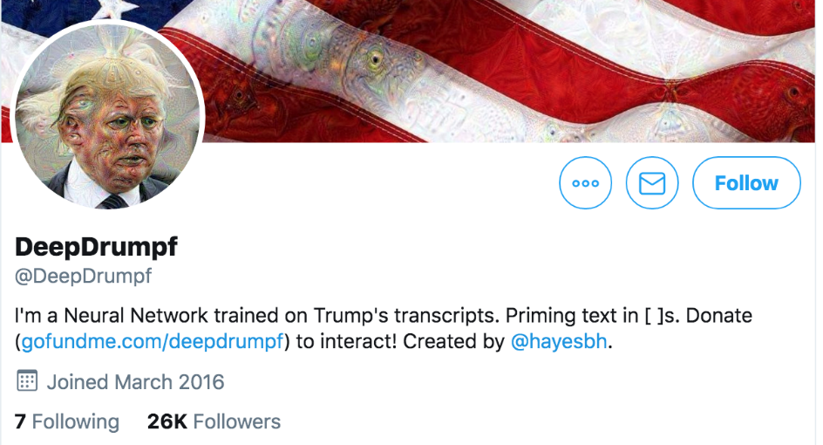
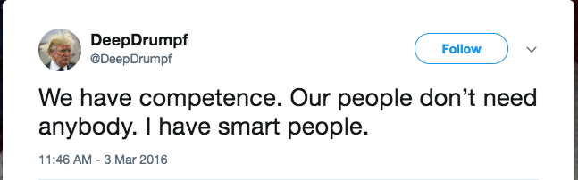
Example Generations of Neural Language Models
Char-by-Char Markdown Generations:
Valid syntax!
Deep “Donald Trump”: Mimic President Trump
'''See also''': [[List of ethical consent processing]]
== See also ==
*[[Iender dome of the ED]]
*[[Anti-autism]]
===[[Religion|Religion]]===
*[[French Writings]]
*[[Maria]]
*[[Revelation]]

Slide 24
ELMo (Peters et al., NAACL’18, best paper)
Add ELMo at the input of RNN. For some tasks (SNLI, SQuAD), including ELMo at the output brings further improvements
Keypoints:
freeze the weight of the biLM
Regularization is necessary

Slide 25
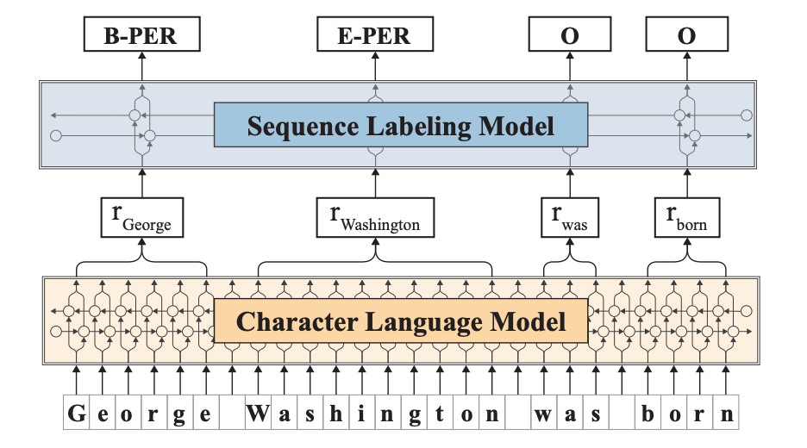
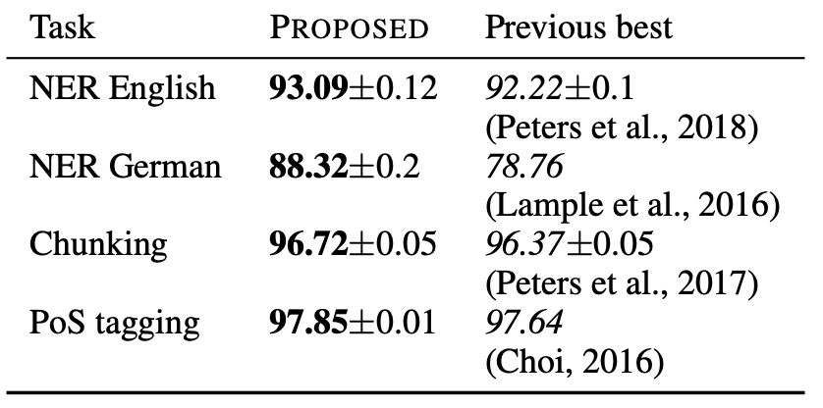
Flair (Akbik et al., COLING’18)
Even for character-level language model, pre-training is very important
The structure is the same with LM-LSTM-CRF, the difference is the pre-training conducted on additional training corpus

Slide 26
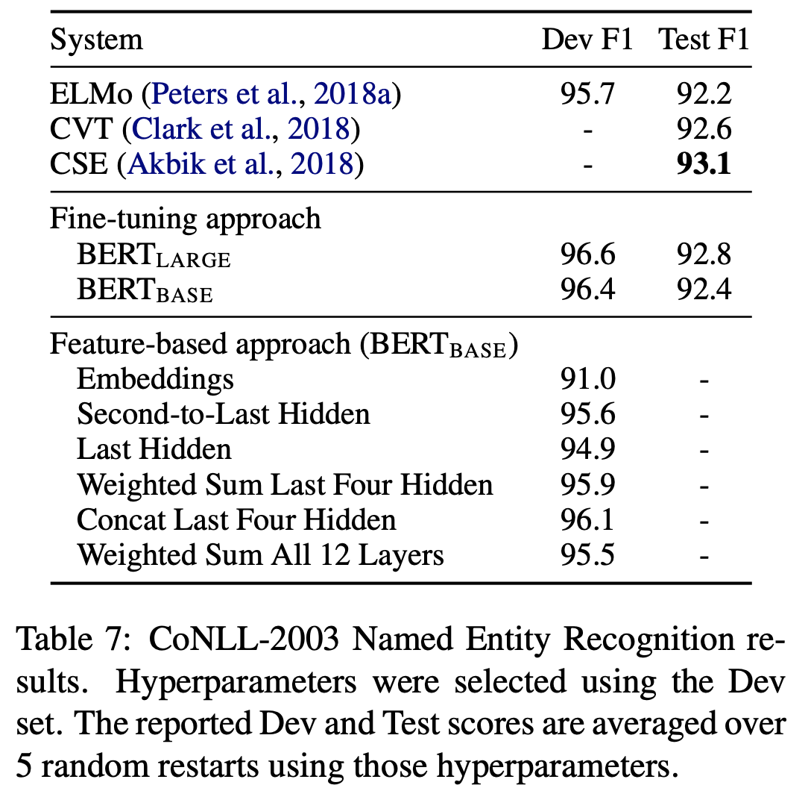
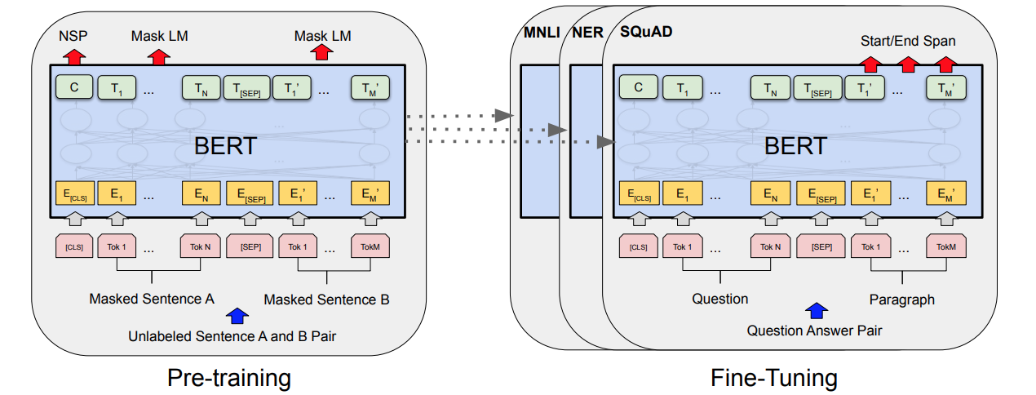
BERT (Devlin et al., NAACL’19, Best Paper)
Introduce Transformers, use masked language model + next sentence prediction
Conduct fine-tuning after pre-training on each task (necessary for sentence-level tasks, NER is a word level task)

Slide 27
Outline
Information Extraction: A Brief Introduction
Named Entity Recognition I: Handcrafted Features + Human Annotations
Rule-based and Classical Supervised Approaches
Named Entity Recognition II: Automated Features + Human Annotations
Language Model-Based Supervised Approaches
Named Entity Recognition III: Automated Features + Distant Annotations
Weakly or Distantly Supervised Approaches for Entity Recognition and Typing
Distantly supervised neural network approach: AutoNER
Summary

Slide 28
Distantly Supervised Approach for NER
ClusType: Open Source: https://github.com/INK-USC/ClusType
“ClusType: Entity Recognition and Typing by Relation Phrase-Based Clustering” [X. Ren, et al., KDD 2015]
CoType: Open Source: https://github.com/INK-USC/USC-DS-RelationExtraction
“CoType: Joint Extraction of Typed Entities and Relations with Knowledge Bases” [X. Ren et al., WWW, 2017]
AutoNER: Open Source: https://github.com/shangjingbo1226/AutoNER
Jingbo Shang, Liyuan Liu, Xiaotao Gu, Xiang Ren, Teng Ren and Jiawei Han, "Learning Named Entity Tagger using Domain-Specific Dictionary", EMNLP'18, Oct. 2018

Slide 29
Why Distant Supervision for Entity Recognition and Typing from Massive Corpora?
Traditional named entity recognition systems are designed for major types (e.g., PER, LOC, ORG) and general domains (e.g., news)
Require additional steps to adapt to new domains/types
Expensive human labor on annotation
500 documents for entity extraction; 20,000 queries for entity linking
Unsatisfying agreement due to various granularity levels and scopes of types
Entities obtained by entity linking techniques have limited coverage and freshness
> 50% unlinkable entity mentions in Web corpus [Lin et al., EMNLP’12]
> 90% in our experiment corpora: tweets, Yelp reviews, …
ClusType: Entity Recognition and Typing by Relation Phrase-Based Clustering [Ren, et al., KDD 2015]
Recognizing entity mentions of target types with minimal/no human supervision and with no requirement that entities can be found in a KB (distant supervision)

Slide 30



Recognizing Typed Entities
Identifying token span as entity mentions in documents and labeling their types
Target Types
The best BBQ I’ve tasted in Phoenix! I had the pulled pork sandwich with coleslaw and baked beans for lunch. ... The owner is very nice. …
The best BBQ:Food I’ve tasted in Phoenix:LOC ! I had the [pulled pork sandwich]:Food with coleslaw:Food and [baked beans]:Food for lunch. … The owner:JOB_TITLE is very nice. …
FOOD
LOCATION
JOB_TITLE
EVENT
ORGANIZATION
…
Plain text
Text with typed entities
FOOD
LOCATION
EVENT
Enabling structured analysis of unstructured text corpus

Slide 31
Entity Extraction with Minimal Human Supervision (I) Weak Supervision
Weak supervision: relies on manually selected seed entities in applying pattern-based bootstrapping methods or label propagation methods to identify more entities
Pattern-Based Bootstrapping: Requires manual seed selection & mid-point checking
Sufficiently frequent & No ambiguity
Patterns for food
the best <X> I’ve tried in
their <X> tastes amazing
…
Seed entities and corpus
Annotate corpus using entities
Generate candidate patterns
Score candidate patterns
Select Top patterns
Apply patterns to find new entities
Seeds for Food
Pizza
French Fries
Hot Dog
Pancake
...
Systems:
UW KnowItAll
CMU NELL
…
Etzioni et al., Unsupervised named-entity extraction from the web: An experimental study, Artificial Intelligence 2005. Mitchell et al. Never-ending Learning, AAAI, 2015

Slide 32

Entity Extraction with Minimal Human Supervision (II) Distant Supervision
Distant supervision: leverages entity information in KBs to reduce human supervision
Detect entity names from text
Link entity names to KB entities
Propagate type information to the unlinkable entities
ID | Sentence
S1 | Phoenix is my all-time favorite dive bar in New York City .
S2 | The best BBQ I’ve tasted in Phoenix.
S3 | Phoenix has become one of my favorite bars in NY .
???
Food
Phoenix
tasted in
BBQ
Location
is my all-time favorite dive bar in
New York City
???
Phoenix
???
→
Location
has become one of my favorite bars in
NY
Lin et al. No noun phrase left behind: detecting and typing unlinkable entities. EMNLP, 2012
Notes:
A recent trend is to use distant supervision. This is the current practice.
Lin et al. No noun phrase left behind: detecting and typing unlinkable entities. EMNLP, 2012.
First, it detects entity mentions from each sentences
[Re-make using a Donald Trump example]

Slide 33
Previous Methods: Limitation I: Domain Restriction
Most existing work assume entity mentions are already extracted by existing entity detection tools, e.g., noun phrase chunkers
Usually trained on general-domain corpora like news articles (clean, grammatical)
Make use of various linguistics features (e.g., semantic parsing structures)
Do not work well on specific, dynamic or emerging domains (e.g., tweets, Yelp reviews)
E.g, “in-and-out” from Yelp review may not be properly detected

Slide 34
Previous Methods: Limitation II: Name Ambiguity
Multiple entities may share the same surface name
Previous methods simply output a single type/type distribution for each surface name, instead of an exact type for each entity mention
While Griffin is not the part of Washington’s plan on Sunday’s game, … | Sport team
…has concern that Kabul is an ally of Washington. | U.S. government
He has office in Washington, Boston and San Francisco | U.S. capital city
While Griffin is not the part of Washington’s plan on Sunday’s game, …
… news from Washington indicates that the congress is going to…
It is one of the best state parks in Washington.
Washington
State
or
Washington
…
Sport
team
Govern
-ment
State

Slide 35
Previous Methods: Limitation III: Context Sparsity
A variety of contextual clues are leveraged to find sources of shared semantics across different entities
Keywords, Wiki concepts, linguistic patterns, textual relations, …
There are often many ways to describe even the same relation between two entities
Previous methods have difficulties in handling entity mention with sparse (infrequent) context
ID | Sentence | Freq
1 | The magnitude 9.0 quake caused widespread devastation in [Kesennuma city] | 12
2 | … tsunami that ravaged [northeastern Japan] last Friday | 31
3 | The resulting tsunami devastate [Japan]’s northeast | 244

Slide 36
Our Recent Efforts on Entity and Relation Typing
ClusType (KDD 2015) GitHub Source https://github.com/shanzhenren/ClusType
Xiang Ren, Ahmed El-Kishky, Chi Wang, Fangbo Tao, Clare R. Voss, Heng Ji, Jiawei Han, "ClusType: Effective Entity Recognition and Typing by Relation Phrase-Based Clustering", in Proc. of 2015 ACM SIGKDD Int. Conf. on Knowledge Discovery and Data Mining (KDD'15), Sydney, Australia, Aug. 2015
PLE (KDD 2016) GitHub Source https://github.com/shanzhenren/PLE
Xiang Ren, Wenqi He, Meng Qu, Clare R. Voss, Heng Ji, Jiawei Han, "Label Noise Reduction in Entity Typing by Heterogeneous Partial-Label Embedding", in Proc. of 2016 ACM SIGKDD Conf. on Knowledge Discovery and Data Mining (KDD'16), San Francisco, CA, Aug. 2016
AFET (EMNLP 2016) GitHub Source: https://github.com/shanzhenren/AFET
Xiang Ren, Wenqi He, Meng Qu, Lifu Huang, Heng Ji, and Jiawei Han, "AFET: Automatic Fine-Grained Entity Typing by Hierarchical Partial-Label Embedding", in Proc. of 2016 Conf. on Empirical Methods in Natural Language Processing (EMNLP'16), Austin, TX, Nov. 2016
CoType (2017) GitHub Source: https://github.com/shanzhenren/CoType
Xiang Ren, Zeqiu Wu, Wenqi He, Meng Qu, Clare Voss, Heng Ji, Tarek Abdelzaher and Jiawei Han, "CoType: Joint Extraction of Typed Entities and Relations with Knowledge Bases", in Proc. of 2017 World-Wide Web Conf. (WWW'17), Perth, Australia, Apr. 2017.

Slide 37
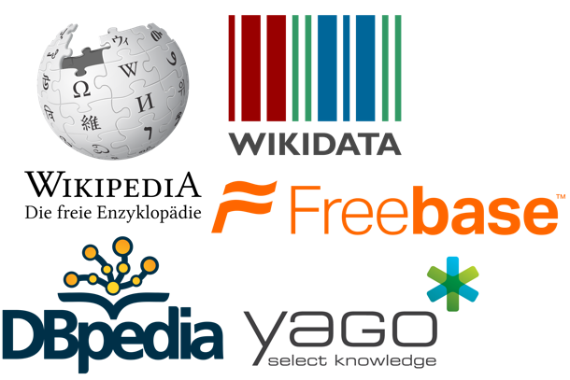
Corpus to Structured Text: Our Roadmap
Text corpus
Data-driven text segmentation
(SIGMOD’15, WWW’16)
entity names
& context units
Structures from the remaining unlabeled data
Learning Corpus-Specific Model
(KDD’15, KDD’16, EMNLP’16, WWW’17)
Partially-labeled corpus
Knowledge
bases
Entity Recognition and Coarse-grained Typing
(KDD’15)
Fine-grained
Entity Typing
(KDD’16, EMNLP’16)
Joint Entity and
Relation Extraction
(WWW’17)
Notes:
At a high-level, Effort-Light StructMine adopts such a workflow.
It starts by breaking the corpus into candidate entity names and context units such as phrases, by running a data-driven text segmentation algorithm.
Then distant supervision is applied to map some of the names and name pairs to knowledge base entities and relationships, and this gives us a partially-labeled corpus as training data.
With the training data, it learns a corpus-specific model that can be used to turn the remaining unlabeled text data into structures.
I have done many pieces of work under this framework. With limited time, I will focus on the model learning.
(show the roadmap) In particular, I will give detailed introduction on the second last step, regarding how to learn corpus-specific models for three StructMine tasks, from entity recognition and typing, to fine-grained entity typing, to relation extraction. Together, these three tasks form a principled approach to turn a corpus into a structured network of facts.
Contributions
Get rid of explicit human labeling on a given corpus
Reduce effort on complex feature engineering
Quick development of corpus-specific models

Slide 38
The ClusType Solution
Domain-agnostic phrase mining algorithm: Extracts candidate entity mentions with minimal linguistic assumption → address domain restriction
E.g., part-of-speech (POS) tagging << semantic parsing
Do not simply merge entity mentions with identical surface names
Model each mention based on its surface name and context, in a scalable way
→ address name ambiguity
Mine relation phrase co-occurring with entity mentions; infer synonymous relation phrases
Helps form connecting bridges among entities that do not share identical context, but share synonymous relation phrases → address context sparsity

Slide 39
The ClusType Framework: Phrase Segmentation and Heterogeneous Graph Construction
POS-constrained phrase segmentation for mining candidate entity mentions and relation phrases, simultaneously
Construct a heterogeneous graph to represent available information in a unified form
Entity mentions are kept as individual objects to be disambiguated
Linked to entity surface names & relation phrases
Weight assignment: The more two objects are likely to share the same label, the larger the weight will be associated with their connecting edge

Slide 40
The ClusType Framework: Mutual Enhancement of Type Propagation and Relation Phrase Clustering
With the constructed graph, formulate a graph-based semi-supervised learning of two tasks jointly:
Derived entity argument types serve as good feature for clustering relation phrases
Type propagation on heterogeneous graph
Propagate type information among entities bridges via synonymous relation phrases
Multi-view relation phrase clustering
Mutually enhancing each other; leads to quality recognition of unlinkable entity mentions

Slide 41
ClusType: A General Framework Overview
Candidate Generation
Perform phrase mining on a POS-tagged corpus to extract candidate entity mentions and relation phrases
Construction of Heterogeneous Graphs
Construct a heterogeneous graph to encode our insights on modeling the type for each entity mention
Collect seed entity mentions as labels by linking extracted mentions to the KB
Relation Phrase Clustering
Estimate type indicator for unlinkable candidate mentions with the proposed type propagation integrated with relation phrase clustering on the constructed graph

Slide 42
Step 1: Candidate Generation
An efficient phrase mining algorithm incorporating both corpus-level statistics and syntactic constraints
Global significance score: Filter low-quality candidates; generic POS tag patterns: remove phrases with improper syntactic structure
By extending TopMine, the algorithm partitions corpus into segments which meet both significance threshold and POS patterns → candidate entity mentions & relation phrases
Algorithm workflow:
Mine frequent contiguous patterns
Performs greedy-agglomerative merging while enforcing our syntactic constraints
Entity mention: consecutive nouns
Relation phrases: shown in the table
Terminates when the next highest-score merging does not meet a pre-defined significance threshold
Relation phrase: Phrase that denotes a unary or binary relation in a sentence

Slide 43
Candidate Generation: Example and Performance
Example output of candidate generation on NYT news articles
Entity detection performance comparison with an NP chunker
Recall is most critical for this step since later we cannot detect the misses (i.e., false negatives)

Slide 44
Step 2: Construction of Heterogeneous Graphs
With three types of objects extracted from corpus: candidate entity mentions, entity surface names, and relation phrases
We can construct a heterogeneous graph to enforce several hypotheses for modeling type of each entity mention (introduced in the following slides)
Basic idea for constructing the graph:
the more two objects are likely to share the same label, the larger the weight will be associated with their connecting edge
Three types of links:
1. Mention-name link: (many-to-one) mappings between entity mention and surface names
2. Name-relation phrase links: corpus-level co-occurrence between surface names and relation phrases
3. Mention correlation links: distributional similarity between entity mentions

Slide 45
Entity Mention-Surface Name Subgraph
Directly modeling type indicator of each entity mention in label propagation
→ Intractable size of parameter space
Both the entity name and the surrounding relation phrases provide strong cues on the types of a candidate entity mention
→ Model the type of each entity mention by (1) type indicator of its surface name; (2) the type signatures of its surrounding relation phrases (more details in the following slides)
…has concerns whether Kabul is an ally of Washington
M candidate mentions;
n surface names
Use a bi-adjacency matrix to represent the mapping
Washington
is an ally of
Gover-
nment
State
…has concerns whether Kabul is an ally of Washington: GOVERNMENT

Slide 46
Entity Name-Relation Phrase Subgraph
Aggregated co-occurrences between entity surface names and relation phrases across corpus → weight importance of different relation phrases for surface names
→ use connected edges as bridges to propagate type information
Left/right entity argument of relation phrase: for each mention, assign it as the left (right) argument to the closest relation phrase on its right (left) in a sentence
Type signature of relation phrase: Two type indicators for its left and right arguments
Hypothesis 1 (Entity-Relation Co-occurrences):
If surface name c often appears as the left (right) argument of relation phrase p, then c's type indicator tends to be similar to the corresponding type indicator in p's type signature.
l different relation phrases, mapping between mentions and relation phrases:
Two bi-adjacency matrices for the subgraph

Slide 47
Mention Correlation Subgraph
An entity mention may have ambiguous name and ambiguous relation phrases
E.g., “White house” and “felt” in the first sentence of Figure
Other co-occurring mentions may provide good hints to the type of an entity mention
E.g., “birth certificate” and “rose garden” in the Figure
→ Propagate type information between candidate mentions of each surface name, based on following hypothesis:
Hypothesis 2 (Mention correlation):
If there exists a strong correlation (i.e., within sentence, common neighbor mentions) between two candidate mentions that share the same name, then their type indicators tend to be similar.
Construct KNN graph based on the feature vector f-surface names of co-occurring entity mentions

Slide 48
Step 3: Relation Phrase Clustering
The type signatures of frequent relation phrases can help infer the type signatures of infrequent (sparse) ones that have similar cluster memberships
Existing work on relation phrase clustering utilizes strings; context words; entity argument to cluster synonymous relation phrases
String similarity and distribution similarity may be insufficient to resolve two relation phrases; type information is particular helpful in such case
We propose to leverage type signature of relation phrase, and propose a general relation phrase clustering method to incorporate different features
Two relation phrases tend to have similar cluster memberships, if they have similar (1) strings; (2) context words; and (3) left and right argument type indicators
Relation phrase clustering is further integrated with the graph-based type propagation in a mutually enhancing framework, based on following hypothesis

Slide 49
RP Clustering: Type Signature Consistency
Observation: many relation phrases have very few occurrences in the corpus
~37% relation phrases have < 3 unique entity surface names (in right or left arguments)
→ Hard to model their type signature based on aggregated co-occurrences with entity surface names (i.e., Hypothesis 1)
Softly clustering synonymous relation phrases:
→ the type signatures of frequent relation phrases can help infer the type signatures of infrequent (sparse) ones that have similar cluster memberships
Hypothesis 3 (Type signature consistency):
If two relation phrases have similar cluster memberships, the type indicators of their left and right arguments (type signature) tend to be similar, respectively.

Slide 50
RP Clustering: Relation Phrase Similarity
Existing work on relation phrase clustering utilizes strings; context words; entity argument to cluster synonymous relation phrases
String similarity and distribution similarity may be insufficient to resolve two relation phrases; type information is particular helpful in such case
We propose to leverage type signature of relation phrase, and proposed a general relation phrase clustering method to incorporate different features
→ further integrated with the graph-based type propagation in a mutually enhancing framework, based on following hypothesis
Hypothesis 4 (Relation phrase similarity):
Two relation phrases tend to have similar cluster memberships, if they have similar (1) strings; (2) context words; and (3) left and right argument type indicators
Type signatures
String features
Context features

Slide 51
Type Inference: A Joint Optimization Problem
Mention modeling & mention correlation (Hypo 2)
Type propagation between entity surface names & relation phrases (Hypo 1)
Multi-view relation phrases clustering) (Hypo 3 & 4)

Slide 52
The ClusType Algorithm
The ClusType algorithm:
Update type indicators and type signatures
For each view, performs single-view NMF until converges
Can be efficiently solved by alternate minimization based on block coordinate descent algorithm
Algorithm complexity is linear to #entity mentions, #relation phrases, #cluster, #clustering features and #target types
Update consensus matrix and relative weights of different views
Until the objective converges

Slide 53
ClusType: Experiment Setting
Datasets: 2013 New York Times news (~110k docs) [event, PER, LOC, ORG]; Yelp Reviews (~230k) [Food, Job, …]; 2011 Tweets (~300k) [event, product, PER, LOC, …]
Seed mention sets: < 7% extracted mentions are mapped to Freebase entities
Evaluation sets: manually annotate mentions of target types for subsets of the corpora
Evaluation metrics: Follows named entity recognition evaluation (Precision, Recall, F1)
Compared methods
Pattern: (Stanford, CONLL’14) Stanford pattern-based learning;
SemTagger: (U. Utah, ACL’10) bootstrapping method which trains contextual classifier based on seed mentions
FIGER (UW, AAAI’12): distantly-supervised sequence labeling method trained on Wiki corpus
NNPLB (UW, EMNLP’12) label propagation using ReVerb assertion and seed mention
APOLLO (THU, CIKM’12): mention-level label propagation using Wiki concepts and KB entities

Slide 54
ClusType: Comparing with the State-of-the-Art Systems
Pattern (Stanford, CONLL’14): explicit textual pattern; semantic drift
NNPLB (UW, EMNLP’12): type propagation on surface name level (name ambiguity)
APOLLO (THU, CIKM’12): context sparsity in type propagation
FIGER (UW, AAAI’12): reliance on complex linguistic features (domain restriction)
ClusType-NoWm: ignore mention correlation; ClusType-NoClus: conducts only type propagation; ClusType-TwoStep: first performs hard clustering then type propagation
Precision (P) = $\frac{\#Correctly−typed mentions }{\#System−recognized mentions}$ , Recall (R) = $\frac{\#Correctly−typed mentions }{\#ground−truth mentions}$, F1 score = $\frac{2\left(P×R\right)}{(P+R) }$

Slide 55
Comparing on Different Entity Types
Obtains larger gain on organization and person (more entities with ambiguous surface names)
Superior performance on product and food mainly comes from the domain independence of our method
Modeling types on entity mention level is critical for name disambiguation
Both NNPLB and SemTagger require sophisticated linguistic feature generation which is hard to adapt to new types

Slide 56
Comparing on Trained NER System
Compare with Stanford NER,which is trained on general-domain corpora including ACE corpus and MUC corpus, on three types: PER, LOC, ORG
F1 score comparison with trained NER
*
ClusType and its variants outperform Stanford NER on both dynamic corpus (NYT) and domain-specific corpus (Yelp)
ClusType has lower precision but higher Recall and F1 score on Tweet → Superior recall of ClusType mainly come from domain-independent candidate generation
* J. R. Finkel, T. Grenager and C. Manning. Incorporating non-local information into information extraction systems by Gibbs sampling. In ACL’05.

Slide 57
Example Output and Relation Phrase Clusters
Example output of ClusType and the compared methods on the Yelp dataset
Extracts more mentions and predicts types with higher accuracy
Example relation phrase clusters and corpus-wide frequency from the NYT dataset
Not only synonymous relation phrases, but also both sparse and frequent relation phrase can be clustered together
→ boosts sparse relation phrases with type information of frequent relation phrases

Slide 58
Testing on Context Sparsity and Surface Name popularity
Surface name popularity:
Group A: high frequency surface name
Group B: infrequent surface name
ClusType outperforms its variants on Group B
→ Handles well mentions with insufficient corpus statistics
Context sparsity:
Group A: frequent relation phrases
Group B: sparse relation phrases
ClusType obtains superior performance over its variants on Group B
→ clustering relation phrase is critical for sparse relation phrases

Slide 59
Distantly Supervised Approach for NER
ClusType: Open Source: https://github.com/INK-USC/ClusType
“ClusType: Entity Recognition and Typing by Relation Phrase-Based Clustering” [X. Ren, et al., KDD 2015]
CoType: Open Source: https://github.com/INK-USC/USC-DS-RelationExtraction
“CoType: Joint Extraction of Typed Entities and Relations with Knowledge Bases” [X. Ren et al., WWW, 2017]
AutoNER: Open Source: https://github.com/shangjingbo1226/AutoNER
Jingbo Shang, Liyuan Liu, Xiaotao Gu, Xiang Ren, Teng Ren and Jiawei Han, "Learning Named Entity Tagger using Domain-Specific Dictionary", EMNLP'18, Oct. 2018

Slide 60

Joint Extraction of Typed Entities and Relations
protest
Washington
D.C.
located at
The Women’s March was a worldwide protest on January 21, 2017. The protest was aimed at Donald Trump, the recently inaugurated president of the United States. The first protest was planned in Washington, D.C., and was known as the Women‘s March on Washington.
aim at
located at
Donald
Trump
Women’s
March
president of
located at
United States
Washington
Person
Location
Organization
Event
Notes:
Concrete example on clarifying input/output of the problem (News on “women’s march”). Clarify concepts: entities/nodes, relationships/edges, StructNet.
Before we answer this question, let’s first clarify what is factual information. To be more specific, I am interested in two kinds of factual structures. First are the real-worlds entities of different categories. For example: Barack Obama is a person, Hawaii is a location; Second, I am also interested in capturing different relations between entities that are expressed in text. For example, one possible relationship between Barack Obama and Hawaii could be “Barack Obama was born in Hawaii”
To unify the factual knowledge in a given corpus, I use a structured network. For the ease of reference, let’s call it StructNet. In a StructNet, nodes represent entities of different entity types; Edges represent entity relationships of different relation types;

Slide 61
Prior Work: An “Incremental” System Pipeline
Error propagation cascading down the pipeline
Entity mention
detection
Context-aware
entity typing
Relation mention detection
Context-aware
relation classification
Entity boundary errors:
The Women’s March was a worldwide protest on January 21, 2017.
Entity type errors:
The Women’s March was a worldwide protest on January 21, 2017. →
person
✗
Relation mention errors:
(women, protest) ✗
(protest, January 21, 2017)
Relation type errors
Relation type errors
✗
is a
✗
is a
(women, protest) →
(protest, January 21, 2017)
Notes:
Re-make the examples

Slide 62

CoType: Joint Extraction of Typed Entities and Relations with Knowledge Bases (WWW’17)
Entity mention detection
1. Data-driven detection of entity and relation mentions
Relation instance detection
Data-driven text segmentation
POS pattern learning from KBs
Context-aware
entity typing
2. Joint typing of entity and relation mentions
Knowledge Bases
Context-aware
relation typing
Noise-robust type modeling
Object “translating” function to model entity-relation interactions
X. Ren et al. CoType: Joint Extraction of Typed Entities and Relations with Knowledge Bases. WWW, 2017.
Notes:
Joint extraction of entities and relations by distant supervision → reduce error propagation

Slide 63
CoType: Co-Embedding for Typing Entities and Relations
Object interactions in a heterogeneous graph
Low-dimensional vector spaces
Notes:
Simplify the example to be more readable.

Slide 64
Modeling Mention-Feature Co-Occurrences
Second-order Proximity
Mentions with similar distributions over text features should have similar types
Vertex m_{i} and m_{j} have a large second-order proximity
president of
???
S7: (Donald Trump, United States)
S6: (Trump, US)
m_{i}
m_{j}
TKN_
Trump
EM2_US
BETWEEN_president
EM2_United States
(Tang et al., WWW’15), (Ren et al. WWW’17)
Notes:
Add formulation

Slide 65

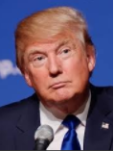


Challenge: “Context-Agnostic Label”
ID | Sentence
S1 | Donald Trump was born in Queens, New York, USA on June 14,1946.
S2 | The protest was aimed at Donald Trump, the recently inaugurated president of the United States.
S3 | There is a method to Donald Trump's madness and he laid it all out in his book, “The Art of the Deal.”
root
product
person
location
organization
politician
artist
businessman
...
Entity types from KB
author
actor
singer
Entity 1
Donald Trump
Entity 2
United States
Type labels for relation mention in S2:
E1: Donald J. Trump | E2: United States
E1 Types: person, politician, businessman, author, actor | E2 Types: location, organization
Relations between E1, E2: president of, citizen of, born in
citizen of
Relation types from KB
president of
born in
Surdeanu et al. Multi-instance multi-label learning for relation extraction. EMNLP, 2012.
Notes:
Need to re-draw figure

Slide 66
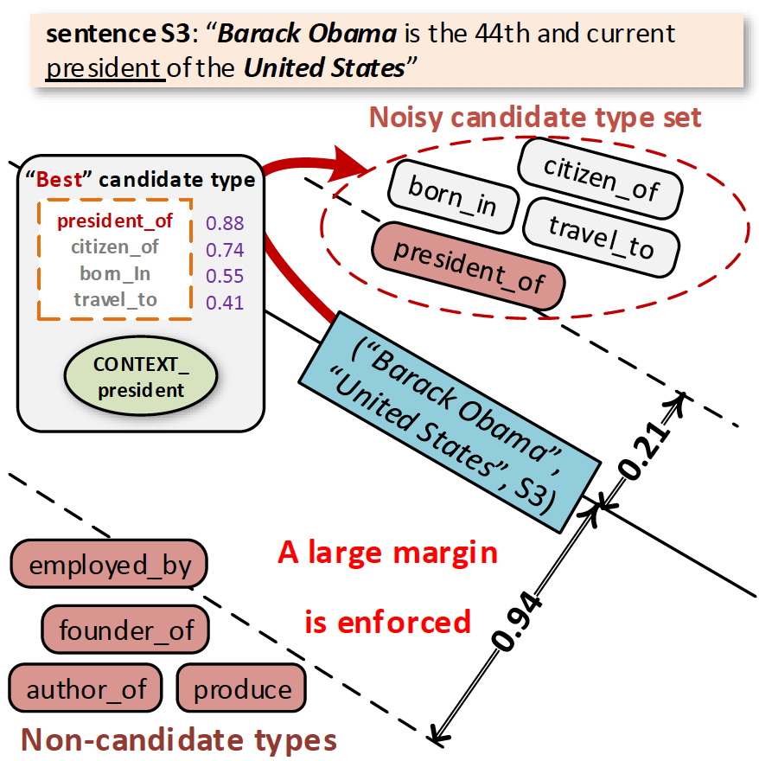
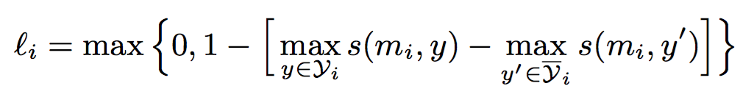
Context-Aware Type Modeling
Partial-label Loss Function
A relation mention should be more similar to its “most relevant” candidate type, than to any other non-candidate type
Enforce: mention is more similar to its “most relevant” candidate type
Score for “most relevant” type
Maximal score for non-candidate types

Slide 67
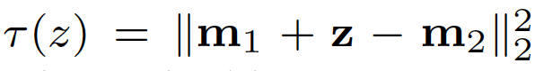
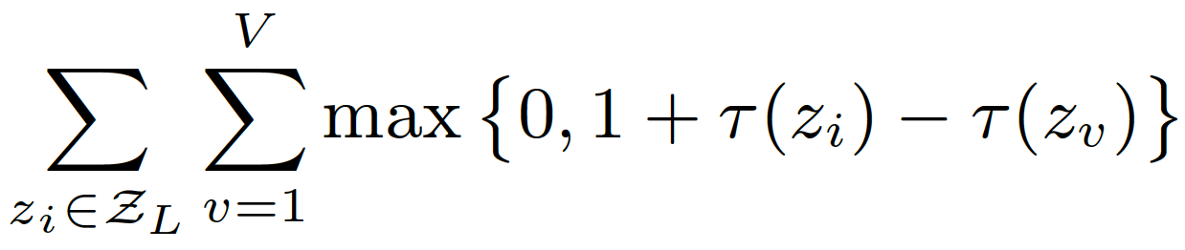
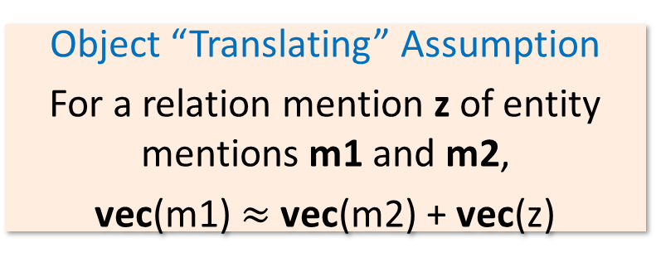
Modeling Entity-Relation Interactions
Error on an entity-relation triple (z, m1, m2):
Object “Translating” Assumption
For a relation mention z of entity mentions m1 and m2,
vec(m1) $≈$ vec(m2) + vec(z)
Enforce: error on a positive triple should be smaller than error on a negative triple
“France”
m1=“USA”
z = capital_city_of
“Paris”
m2=“Washington D.C.”
positive
relation triple
negative
relation triple
Embedding space
Notes:
Use entity-relation interaction to constraint the types of each other, yielding a more robust model

Slide 68
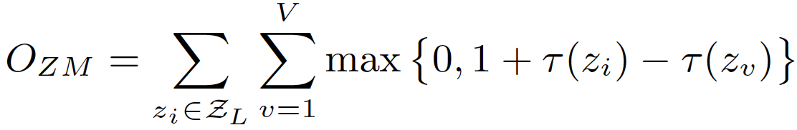
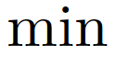
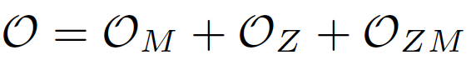
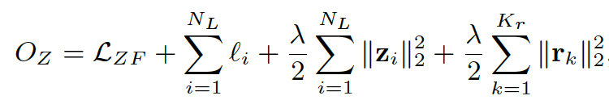
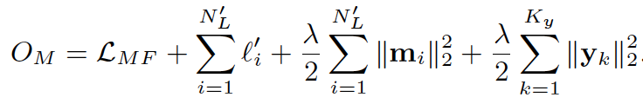
Reducing Error Propagation: A Joint Optimization Framework
Modeling Entity-relation interactions
Modeling relation mentions
Modeling entity mentions
Please refer the paper for details:
X. Ren et al. CoType: Joint Extraction of Typed Entities and Relations with Knowledge Bases. WWW2017.

Slide 69
CoType: Comparing with State-of-the-Arts RE Systems
Given candidate relation mentions, predict its relation type if it expresses a relation of interest; otherwise, output “None”
DeepWalk (StonyBrook, KDD’14): homogeneous graph embedding
DS+Logistic (Stanford, ACL’09): trains logistic classifier on DS
LINE (MSR, WWW’15): joint feature and type embedding
MultiR (UW, ACL’11): distantly-supervised, models noisy labels
CoType-RM (WWW’17): only models relation mentions
CoType (WWW’17): models entity-relation interactions

Slide 70
Distantly Supervised Approach for NER
ClusType: Open Source: https://github.com/INK-USC/ClusType
“ClusType: Entity Recognition and Typing by Relation Phrase-Based Clustering” [X. Ren, et al., KDD 2015]
CoType: Open Source: https://github.com/INK-USC/USC-DS-RelationExtraction
“CoType: Joint Extraction of Typed Entities and Relations with Knowledge Bases” [X. Ren et al., WWW, 2017]
AutoNER: Open Source: https://github.com/shangjingbo1226/AutoNER
Jingbo Shang, Liyuan Liu, Xiaotao Gu, Xiang Ren, Teng Ren and Jiawei Han, "Learning Named Entity Tagger using Domain-Specific Dictionary", EMNLP'18, Oct. 2018

Slide 71
Prior Arts on Distantly Supervised NER
Distantly Supervised NER
Input
Unlabeled raw texts
An entity dictionary: (Entity type, canonical name, [synonym₁, …, synonym_{k}])
Or, a knowledge-base (e.g., DBpedia, Freebase)
Output
An NER model to recognize the entities of the entity types in the given dictionary (the entities to be recognized can be unseen entities)
Methods for distantly supervised NER
String-match/rule-based distant supervision generation
AutoEntity, SwellShark, ClusType, …
Leave the entity span detection to experts
POS Tag Rule-based (e.g., regular expressions)

Slide 72
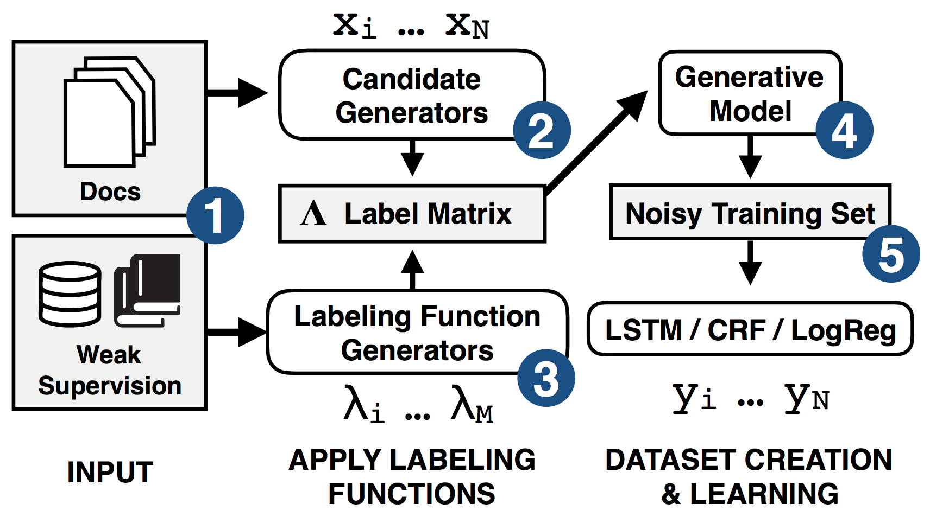
Prior Arts: SwellShark (Fries et al, 2017)
Data Programming for Entity Typing
Entity detection: Regular expressions based on part-of-speech tags
Requires expert efforts
Candidate Generators
Jason Fries, Sen Wu, Alex Ratner, and Christopher Ré. "SwellShark: A Generative Model for Biomedical Named Entity Recognition without Labeled Data“, arXiv:1704.06360 (2017)

Slide 73
Prior Arts – ClusType (Xiang et al, KDD’15): Phrase Segmentation and Heterogeneous Graph Construction
POS-constrained phrase segmentation for mining candidate entity mentions and relation phrases, simultaneously
Construct a heterogeneous graph to represent available information in a unified form
Entity mentions are kept as individual objects to be disambiguated
Linked to entity surface names & relation phrases
Weight assignment: The more two objects are likely to share the same label, the larger the weight will be associated with their connecting edge
Xiang Ren, Ahmed El-Kishky, Chi Wang, Fangbo Tao, Clare R. Voss, and Jiawei Han. "Clustype: Effective entity recognition and typing by relation phrase-based clustering." In KDD’15

Slide 74
Prior Arts: Distant-LSTM-CRF (Giannakopoulos et al., 2018)
AutoPhrase + LSTM-CRF
AutoPhrase generates labels
Heuristically set thresholds
LSTM-CRF builds models
Both word & char info are used
Problem
High thresholds needed for clean positive labels
➔ many false-negative labels
Athanasios Giannakopoulos, Claudiu Musat, Andreea Hossmann, and Michael Baeriswyl. "Unsupervised Aspect Term Extraction with B-LSTM & CRF using Automatically Labelled Datasets." In Proceedings of the 8th Workshop on Computational Approaches to Subjectivity, Sentiment and Social Media Analysis, pp. 180-188. 2017

Slide 75
Review: From Neural Networks to Deep Learning
Train networks with many layers (vs. shallow nets with just a couple of layers)
More neurons than previous networks
More complex ways to connect layers
Tremendous computing power to train networks
Automatic feature extraction
Multiple layers work to build an improved feature space
Analogy: Signals passing through regions of the visual cortex
Example: For face recognition: edge → nose → face, layer-by-layer
Popular Deep Learning Frameworks for Classification
Deep Feedforward Neural Networks
Convolutional Neural Networks
Recurrent Neural Networks
Notes:
75

Slide 76

Review: Recurrent Neural Networks: General Concepts
Modeling the time dimension: by creating cycles in the network (thus “recurrent”)
Adding feedback loops connected to past decisions
Long-term dependencies: Use hidden states to preserve sequential information
RNNs are trained to generate sequences: Output at each timestamp is based on both the current input and the inputs at all previous timestamps
Compute a gradient with the algorithm BPTT (backpropagation through time)
Major obstacles of RNN: Vanishing and Exploding Gradients
When the gradient becomes too large or too small, it is difficult to model long-range dependencies (10 timestamps or more)
Solution: Use a variant of RNN: LSTM (1997, by Hochreiter and Schmidthuber)
Notes:
76
https://deeplearning4j.org/lstm.html

Slide 77
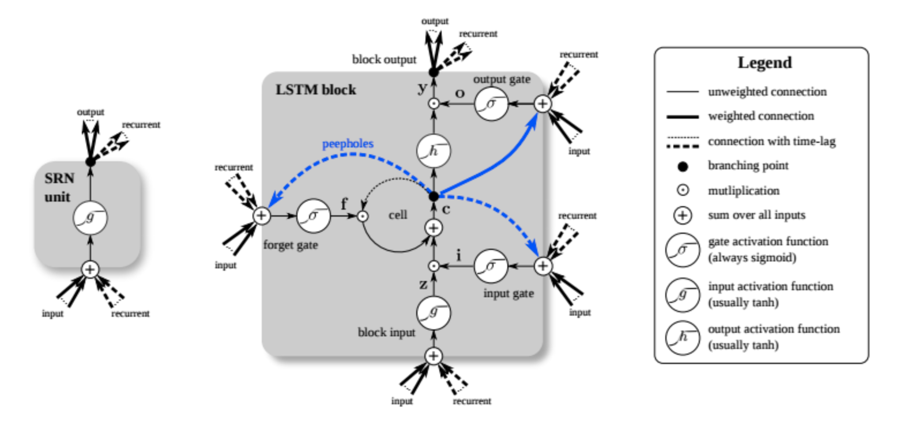
Review: LSTM: One Variant of Recurrent Neural Network
Critical components of LSTM
Memory cells
3 Gates (input, forget, output)
Use gated cells to
Write, store, forget information
When both gates are closed
The contents of the memory cell will remain unmodified
The gating structure allows information to be retained across many timestamps
Also allows gradient to flow across many timestampls
By back-propagating errors and adjusting weights, to learn what to store, and when to allow reads, writes and erasures
Applications: Handling sequence and time series data
E.g., NLP, video analysis, image captioning, robotics control
Notes:
77
https://deeplearning4j.org/lstm.html

Slide 78
Prior Arts: Drawbacks
String Match
High precision but low recall
Cannot recognize new entities
AutoEntity, SwellShark, ClusType, …
Still require domain experts to design rules to accurately extract entity mention spans
Distant-LSTM-CRF
Poor performance due to the low label quality
Can only handle one entity type

Slide 79
Major Challenges: False Positive Labels
If a token span can be matched to some entity (or synonym) in the dictionary, is it safe to say it is an entity?
No! It can be matched to some strange synonyms
Ex.: When the dictionary has a non-related character name “Wednesday Addams”, many Wednesday’s will be wrongly marked as persons
Solution: Remove ”irrelevant” entities
Remove an entity if its canonical name never occurs in the given corpus
Intuition: People will likely mention the canonical name of the entity at least once to avoid ambiguity

Slide 80
Major Challenges: False Negative Labels
If a token span cannot be matched to any entity (or synonym) in the dictionary, is it safe to say it’s non-entity?
No! Dictionary’s coverage is usually limited
Solution: Introduce out-of-dictionary high-quality phrases as new entities
Their types are “unknown”
It could be any IOBES + any type
Conventional CRF cannot handle this case
Let’s create a Fuzzy CRF!

Slide 81
LM-LSTM-CRF (Liu et al., AAAI’18)
Propose to use character-level language model as a Co-Training objective:
Character-level language model is efficient → Do not require additional training data
Character-level language model is more robust to pre-processing

Slide 82
LM-LSTM-CRF: An Effective Sequence Labeling Framework
For character-level knowledge: A neural language model with sequence labeling
Multitask learning to guide the language model towards task-specific key knowledge
Transform the output of character-level layers into different semantic spaces for different objectives
Character-level neural language models are trained purely on unannotated sequence data but can capture the underlying style and structure
Aiming to capture lexical features instead of remembering words’ spelling, we adjust the prediction from the next character to the next word
Couple two LSTM units to capture info. in both forward and backward directions
Highway Layer: Allow unimpeded information flowing across several layers
For word-level knowledge, we choose to fine-tune pre-trained word embeddings instead of co-training or pretraining the whole word-level layers
CRF for Sequence Labeling: Build a CRF layer upon the word-level LSTM—jointly decoding a chain of labels can ensure the resulting label sequence meaningful (e.g., not meaningful to annotate I-PER after B-ORG)
Our neural Language Model: Makes predictions for words but takes the character sequence as input
LM-LSTM-CRF is very popular at Github (with over 500 stars and 158 forks)

Slide 83
AutoNER (Shang et al., 2018): Dual Dictionaries
A core dictionary
Leads to high-precision but low-recall matches
A “full” dictionary
Leads to high-recall but low-precision matches
Introduce out-of-dictionary high-quality phrases as new entities
Their types are “unknown”
It could be any IOBES + any type

Slide 84
AutoNER: Learning Named Entity Tagger using Domain-Specific Dictionary
Jingbo Shang, Liyuan Liu, Xiaotao Gu, Xiang Ren, Teng Ren and Jiawei Han, "Learning Named Entity Tagger using Domain-Specific Dictionary", in EMNLP’18
Motivation: Use deep neural networks to build reliable NER systems without handcrafting features, replacing manual annotation by distant supervision (with dictionaries, i.e., open knowledge-bases, such as Wiki, Yago, MeSH, etc.)
Method:
For sequence labeling, propose a revised fuzzy CRF layer to handle tokens with multiple possible labels
Extract high-quality phrases as potential entities with a special “unknown” type
A more effective neural model AutoNER with a new Tie or Break scheme
Instead of predicting the label of each single token, we predict whether two adjacent tokens are tied in the same entity mention or not (i.e., broken)
Software on Github: AutoNER has 124 stars and 27 forks (12/20/18)

Slide 85
Fuzzy-LSTM-CRF
The illustration of the Fuzzy CRF layer with modified IOBES tagging scheme. The named entity types are {Chemical, Disease}. “indomethacin” is a matched Chemical entity and “prostaglandin synthesis” is an unknown-typed high-quality phrase. Paths from Start to End marked as purple form all possible label sequences given the distant supervision
One Observation: Even if the boundaries of an entity mention are mismatched by distant supervision, most of its inner ties are not affected
E.g., in “Knowledge Discovery and Data Mining”, if only “Data Mining” was dictated as a quality phrase, even if the detected boundary between “and” and “Data” is wrong, the boundary between “Data” and “Mining” would still be correct

Slide 86
A Tie-or-Break Scheme in AutoNER
Tie or Break: Instead of labeling each token, we choose to tag the connection between two adjacent tokens
For every two adjacent tokens, the connection between them is labeled as
Tie, when the two tokens are matched to the same entity
Unknown, if at least one of the tokens belongs to an unknown-typed high-quality phrase
Break, otherwise
Advantage
Compared to multi-word entity mentions, matched unigram entity mentions are more likely to be false-positive labels
However, such false-positive labels will not introduce incorrect labels with the “Tie or Break” scheme, since either the unigram is a true entity mention or a false positive, it always brings two Break labels around

Slide 87
AutoNER: Framework

Slide 88
Comparison—Biomedical Domain

Slide 89
Comparison: Technical Review Domain
This dataset is from a SemEval challenge
AutoNER outperforms the distantly supervised benchmark
Both AutoNER and Fuzzy-LSTM-CRF are better than String Match
AutoNER is better than Fuzzy-LSTM-CRF
AutoNER is competitive to the supervised benchmark
i.e., challenge winner’s solution

Slide 90
Comparison—Ablation Test
Dictionary tailoring is helpful to precisions
Phrase mining is helpful to recalls

Slide 91
Comparison: Size of the Raw Texts
More raw texts ➔ Better models
Gold annotations help a lot

Slide 92
Outline
Information Extraction: A Brief Introduction
Named Entity Recognition I: Handcrafted Features + Human Annotations
Rule-based and Classical Supervised Approaches
Named Entity Recognition II: Automated Features + Human Annotations
Language Model-Based Supervised Approaches
Named Entity Recognition III: Automated Features + Distant Annotations
Weakly or Distantly Supervised Approaches for Entity Recognition and Typing
Distantly supervised neural network approach: AutoNER
Summary

Slide 93
Summary
Information Extraction: A Brief Introduction
Named Entity Recognition I: Handcrafted Features + Human Annotations
Rule-based and Classical Supervised Approaches
Named Entity Recognition II: Automated Features + Human Annotations
Language Model-Based Supervised Approaches
Named Entity Recognition III: Automated Features + Distant Annotations
Weakly or Distantly Supervised Approaches for Entity Recognition and Typing
ClusType + CoType
Distantly supervised neural network approach: AutoNER

Slide 94
References (I)
Alan Akbik, Duncan Blythe, and Roland Vollgraf. "Contextual String Embeddings for Sequence Labeling." In COLING 2018
Jenny Rose Finkel, Trond Grenager, and Christopher Manning. Incorporating Non-local Information into Information Extraction Systems by Gibbs Sampling. ACL 2005
Jason Fries, Sen Wu, Alex Ratner, and Christopher Ré. "SwellShark: A Generative Model for Biomedical Named Entity Recognition without Labeled Data." arXiv preprint arXiv:1704.06360 (2017)
L. Gal´arraga, G. Heitz, K. Murphy, and F. M. Suchanek. Canonicalizing open knowledge bases. CIKM’14
Athanasios Giannakopoulos, Claudiu Musat, Andreea Hossmann, and Michael Baeriswyl. "Unsupervised Aspect Term Extraction with B-LSTM & CRF using Automatically Labelled Datasets." In Proceedings of the 8th Workshop on Computational Approaches to Subjectivity, Sentiment and Social Media Analysis, 2017
S. Gupta and C. D. Manning. Improved pattern learning for bootstrapped entity extraction. CONLL’14
Z. Kozareva and E. Hovy. Not all seeds are equal: Measuring the quality of text mining seeds. NAACL’10
H. Huang, Y. Cao, X. Huang, H. Ji and C. Lin. Collective Tweet Wikification based on Semi-supervised Graph Regularization. ACL’14
R. Huang and E. Riloff. Inducing domain-specific semantic class taggers from (almost) nothing. ACL’10
Guillaume Lample, Miguel Ballesteros, Sandeep Subramanian, Kazuya Kawakami, and Chris Dyer. "Neural Architectures for Named Entity Recognition." In Proceedings of NAACL-HLT, 2016

Slide 95
References (2)
T. Lin, O. Etzioni, et al. No noun phrase left behind: detecting and typing unlinkable entities. EMNLP’12
X. Ling and D. S. Weld. Fine-grained entity recognition. AAAI’12
Liyuan Liu, Xiang Ren, Jingbo Shang, Xiaotao Gu, Jian Peng and Jiawei Han, "Efficient Contextualized Representation: Language Model Pruning for Sequence Labeling", in EMNLP’18
Liyuan Liu, Jingbo Shang, Frank Xu, Xiang Ren, Huan Gui, Jian Peng and Jiawei Han, "Empower Sequence Labeling with Task-Aware Neural Language Model", in AAAI'18
Ma and Eduard Hovy. "End-to-end Sequence Labeling via Bi-directional LSTM-CNNs-CRF." In ACL’16
N. Nakashole, T. Tylenda, and G. Weikum. Fine-grained semantic typing of emerging entities. ACL’13
Matthew Peters, Mark Neumann, Mohit Iyyer, Matt Gardner, Christopher Clark, Kenton Lee, and Luke Zettlemoyer. "Deep Contextualized Word Representations." In NAACL-HLT’18
Lev Ratinov and Dan Roth. "Design challenges and misconceptions in named entity recognition." In Proceedings of the Thirteenth Conference on Computational Natural Language Learning, pp. 147-155, 2009
Nils Reimers and Iryna Gurevych. "Reporting Score Distributions Makes a Difference: Performance Study of LSTM-networks for Sequence Tagging." In EMNLP’17
Xiang Ren, Ahmed El-Kishky, Chi Wang, Fangbo Tao, Clare R. Voss, Heng Ji, Jiawei Han, "ClusType: Effective Entity Recognition and Typing by Relation Phrase-Based Clustering", in Proc. of 2015 ACM SIGKDD Int. Conf. on Knowledge Discovery and Data Mining (KDD'15), Sydney, Australia, Aug. 2015

Slide 96
References (3)
Xiang Ren, Zeqiu Wu, Wenqi He, Meng Qu, Clare Voss, Heng Ji, Tarek Abdelzaher and Jiawei Han, "CoType: Joint Extraction of Typed Entities and Relations with Knowledge Bases", WWW’17
Xiang Ren, Wenqi He, Meng Qu, Lifu Huang, Heng Ji, and Jiawei Han, "AFET: Automatic Fine-Grained Entity Typing by Hierarchical Partial-Label Embedding", EMNLP’16
Xiang Ren, Wenqi He, Meng Qu, Clare R. Voss, Heng Ji, Jiawei Han, "Label Noise Reduction in Entity Typing by Heterogeneous Partial-Label Embedding", KDD'16
Alan Ritter, Sam Clark, and Oren Etzioni. "Named entity recognition in tweets: an experimental study." In EMNLP’11
Alan Ritter, Oren Etzioni, and Sam Clark. "Open domain event extraction from twitter." In Proceedings of 2012 SIGKDD international conference on Knowledge discovery and data mining, pp. 1104-1112
Jingbo Shang, Liyuan Liu, Xiaotao Gu, Xiang Ren, Teng Ren and Jiawei Han, "Learning Named Entity Tagger using Domain-Specific Dictionary", in EMNLP’18
W. Shen, J. Wang, P. Luo, and M. Wang. A graph-based approach for ontology population with named entities. CIKM’12
P. P. Talukdar and F. Pereira. Experiments in graph-based semi-supervised learning methods for class-instance acquisition. ACL’10
Xuan Wang, Yu Zhang, Xiang Ren, Yuhao Zhang, Marinka Zitnik, Jingbo Shang, Curtis Langlotz, and Jiawei Han. "Cross-type Biomedical Named Entity Recognition with Deep Multi-Task Learning." Bioinformatics (2018)

